Slide 1
Artificial Intelligence and Machine Learning
Project
NYC YELLOW TAXI SYSTEM
Team Details:
Hanish Mittal 2210991604
Himanshu Malhotra 2210991663
Harsh 2210991612
Harsh 2210991614
Faculty Coordinator:
Shubham Singhal
Team Details:
Hanish Mittal 2210991604
Himanshu Malhotra 2210991663
Harsh 2210991612
Harsh 2210991614
Faculty Coordinator:
Dr Monica Dutta
:
Chitkara University Institute of Engineering and Technology,
Chitkara University, Punjab

Slide 2
Table of Contents
Introduction
Objective
Tools used
Data Summary
Exploratory Data Analysis
Challenges

Slide 3
INTRODUCTION
• The New York City (NYC) yellow taxi system is an iconic and essential component of the city's transportation network. With its fleet of distinctively colored vehicles navigating the bustling streets, the yellow taxi system serves as a ubiquitous and reliable mode of transit for millions of residents and visitors every day.
• NYC yellow taxi fleet comprises thousands of licensed vehicles, each operated by skilled drivers who undergo rigorous training and screening processes. These taxis are strategically deployed across the city to meet the demand for transportation services, with drivers navigating diverse routes and serving a broad spectrum of passengers, from commuters to tourists.

Slide 4
Objective
•Provide Reliable Transportation: offer reliable transportation services to passengers throughout the city. availability of taxis in high-demand areas, especially during peak hours, and maintaining efficient dispatching systems to minimize wait times.
•Ensure Passenger Safety: Another crucial objective is to prioritize passenger safety. This involves implementing and enforcing regulations related to vehicle maintenance, driver qualifications, and adherence to traffic laws.
•Promote Environmental Sustainability: The NYC yellow taxi system aims to minimize its environmental impact by promoting the use of cleaner and more fuel-efficient vehicles.
•Improve Efficiency and Convenience: Efficiency and convenience are key objectives of the yellow taxi system

Slide 5
Tools Used
•collab notebook is used as IDE.
•Pandas and NumPy are used for Data Manipulation &
Pre-processing and Mathematical functions respectively.
•Exploratory data analysis is automated by data prep.
•For visualization of the plots, Matplotlib, Seaborn, Plotty are used.
•GitHub is used as version control system

Slide 6

DATA SUMMARY
Numerical Data
passenger_count​
trip_distance​
pickup_longitude​
pickup_latitude​
dropoff_longitude​
dropoff_latitude​
fare_amount​
extra​
mta_tax​
tip_amount​
tolls_amount​
improvement_surcharge​
total_amount
Unique Data
VendorID​
RatecodeID​
store_and_fwd_flag​
payment_type​
Categorical Data​
VendorID​
RatecodeID​
store_and_fwd_flag​
payment_type

Slide 7
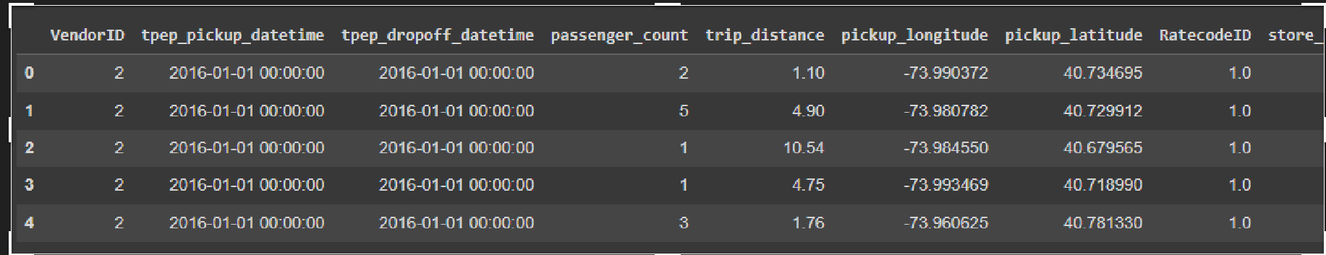
This is the yellow taxi dataset. In the below table it shows the top 3 rows

Slide 8
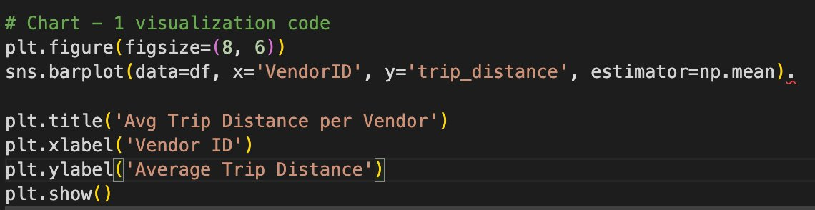
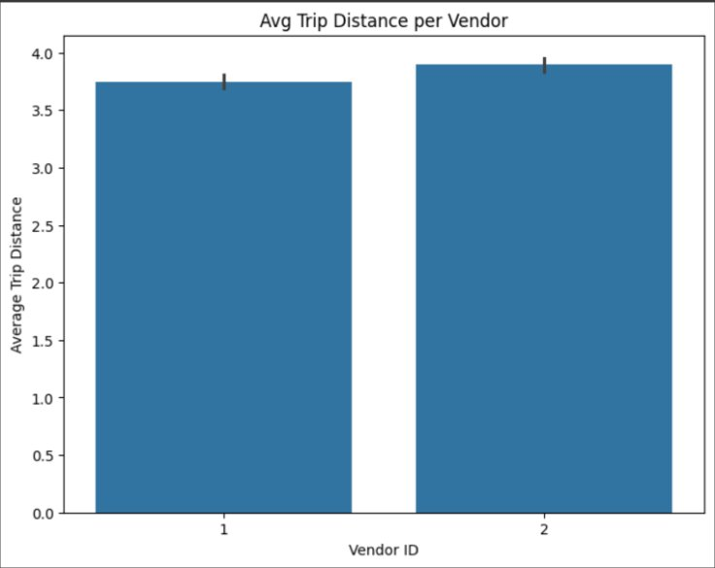
Average trip distance per vendor

Slide 9
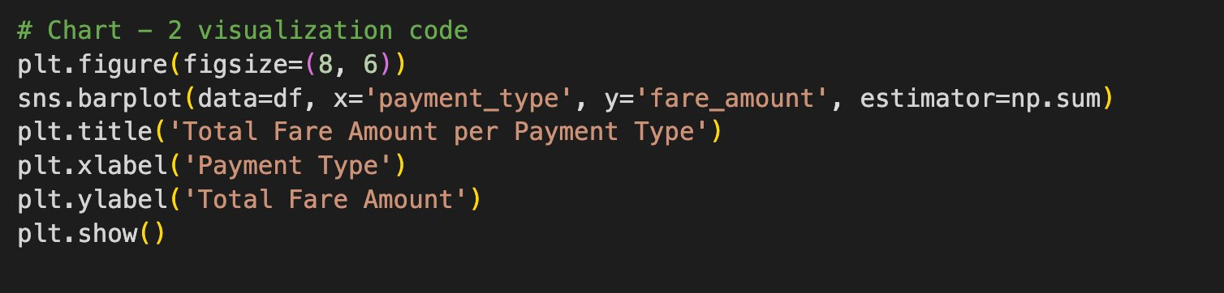
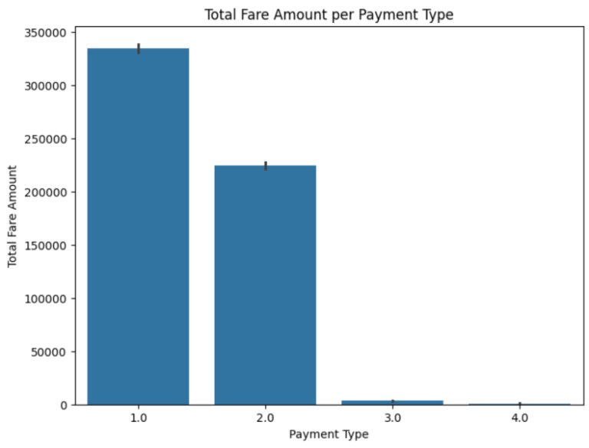
Total Fare Amount Per Payment Type

Slide 10
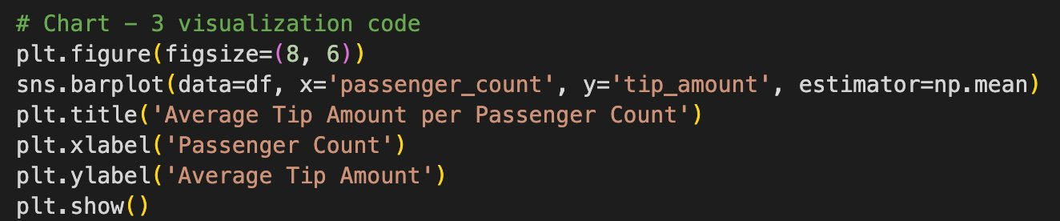
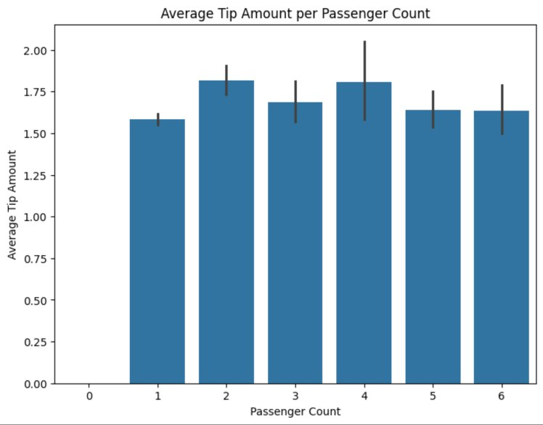
Average tip amount per passenger count

Slide 11
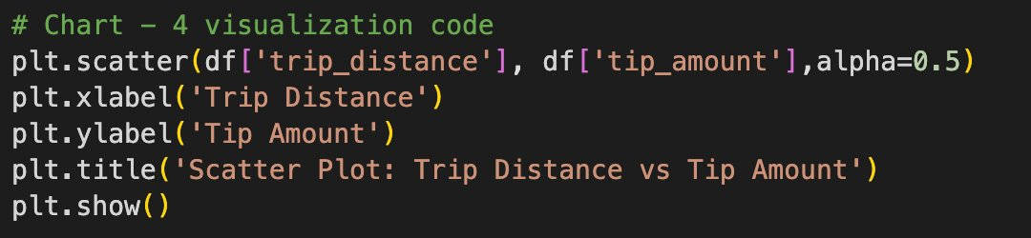
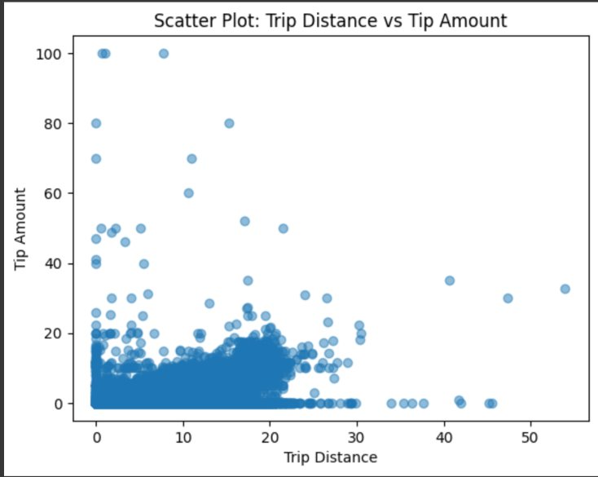
Scatter Plot : Trip Distance vs Tip Amount

Slide 12
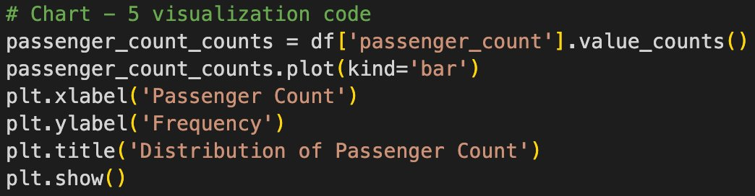
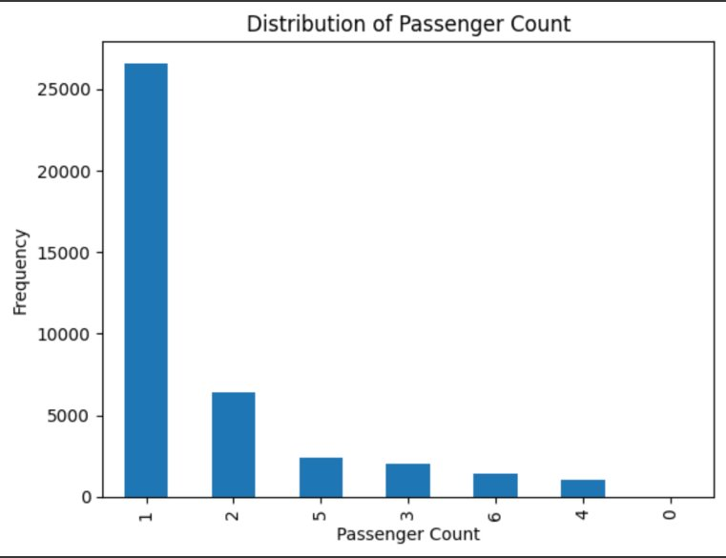
Distribution Of Passenger Count

Slide 13
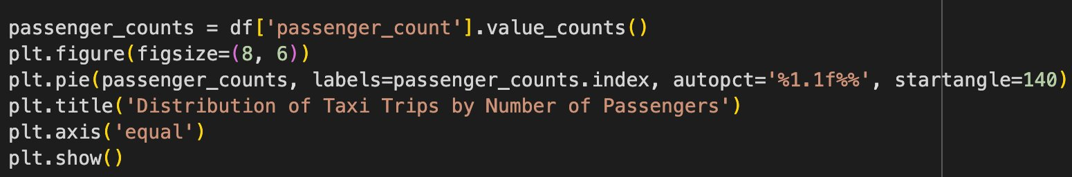
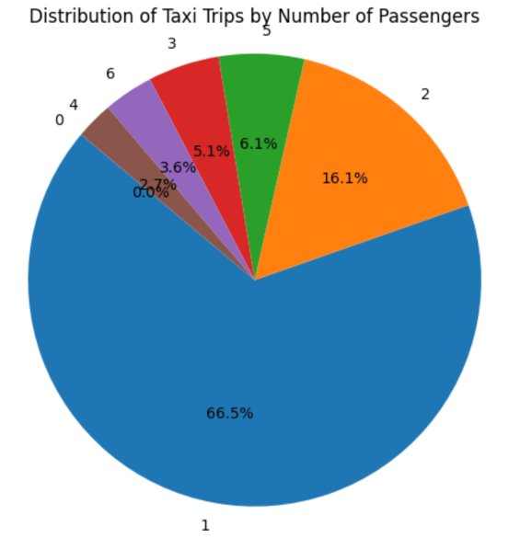
distribution of taxi trips by number of passengers

Slide 14
CHALLENGES
Ridesharing Competition: Just like traditional taxi companies elsewhere, NYC taxis are directly competing with ridesharing giants like Uber and Lyft. These companies offer similar services with added conveniences like mobile app booking, cashless transactions, and driver ratings.
Congestion and Traffic: NYC's dense urban environment leads to heavy traffic congestion, making it challenging for taxis to navigate the city efficiently. Ridesharing companies may have an advantage here, as they can utilize algorithms to optimize routes and avoid congestion more effectively.
High Operating Costs: Operating a taxi in NYC is expensive, with costs including fuel, maintenance, insurance, and lease payments for medallions or vehicles. These costs can eat into drivers' earnings and make it difficult for taxi companies to remain profitable, especially in the face of competition from ridesharing services

Slide 15
References
The reference used are :
• https://www.kaggle.com/datasets/elemento/nyc-yellow-taxi-trip-data/data/

